Slide 1
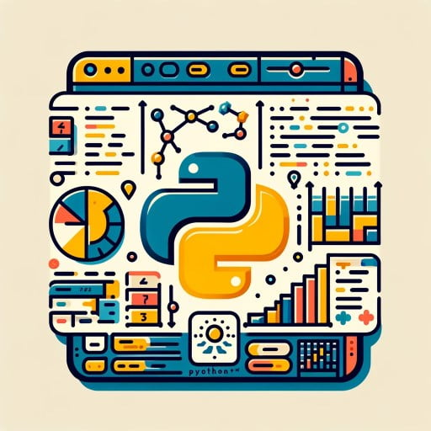
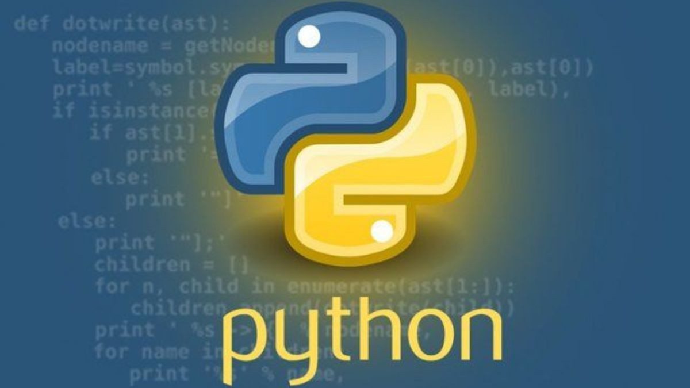
Introduction to Data Science: Python Workshop
Association of Data Science

Slide 2
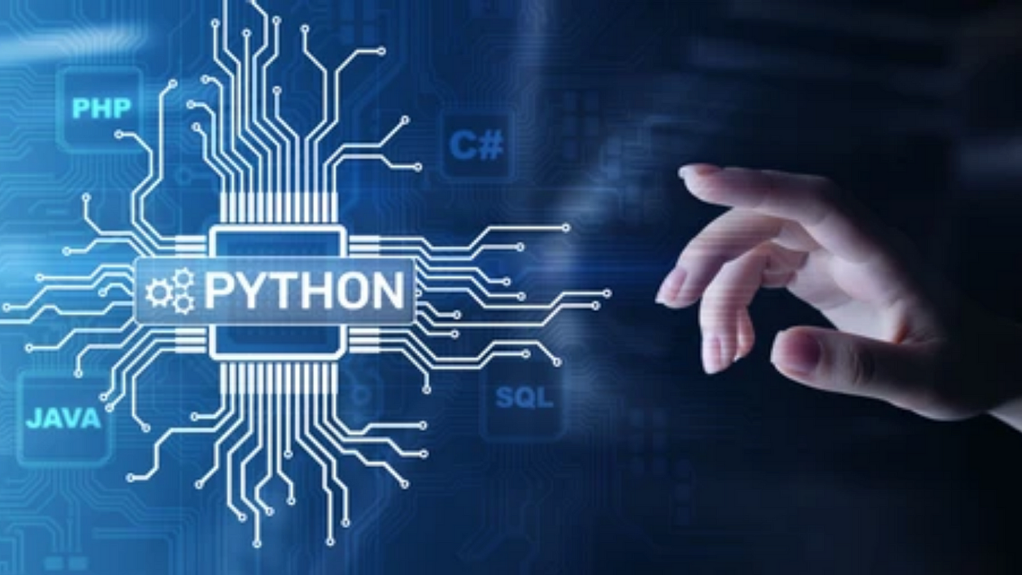
Python Fundamentals for Data Science:
Python basics: Understanding basic Python syntax, data types (integers, floats, strings, lists, dictionaries, etc.), and control flow (if statements, loops, and functions).
Example: For loop
for i in range(5):
print(i)
Open an IDE with access to Python (e.g., VS Code), open your chosen folder and create an .ipynb file
Libraries: Know how to import libraries, install them using pip in your terminal (pip install ‘library name’), and use them in your code.
Example: Importing pandas library
import pandas as pd
Data structures: Understanding and working with pandas Series, DataFrames, and numpy arrays.
Example: Importing Numpy, setting data variable to an array
import numpy as np
data = np.array([1, 2, 3, 4, 5])

Slide 3
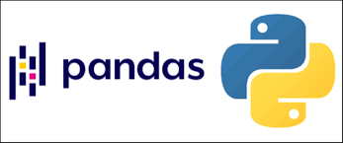
Data Manipulation with Pandas:
Loading and inspecting data: Reading data from CSV, Excel, SQL databases into pandas DataFrames and exploring basic DataFrame attributes and methods.
Example: Creating data frame ‘df’ by reading in a csv file by calling the ‘read_csv’ function to the Pandas instance ‘pd’
df = pd.read_csv('data.csv')
Data cleaning: Handling missing values, data formatting (converting data types), and dealing with duplicates.
Example: Handling null values using dropna function
df.dropna(inplace=True)
Data manipulation: Selecting specific columns, filtering rows, grouping data, merging/joining datasets, and reshaping data to cater specific needs for the task at hand.
Example: Creating variable ‘df_filtered’ that stores columns named 'column_name' that are greater than 0
df_filtered = df[df['column_name'] > 0]

Slide 4
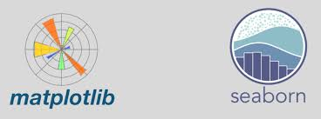
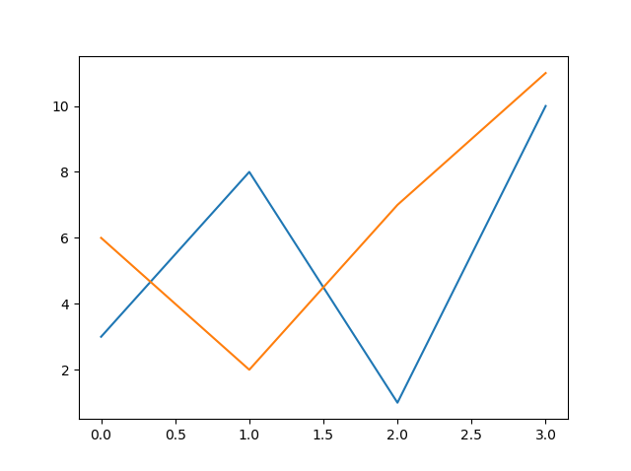
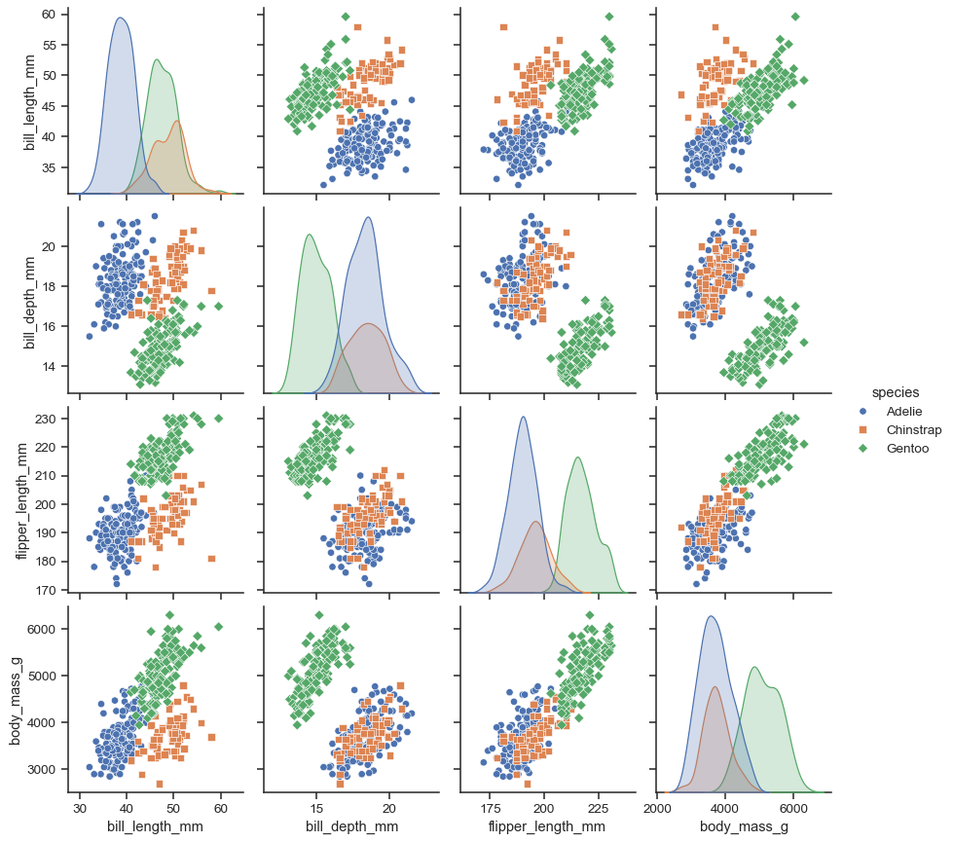
Data Visualization with Matplotlib
and Seaborn:
Plotting basics: Creating different types of plots (line, scatter, bar, histogram) using matplotlib.
Example: Importing matplotlib and creating a line plot
import matplotlib.pyplot as plt
plt.plot(x, y)
plt.show()
Customizing plots: Adding titles, labels, legends, colors, and styles to plots.
plt.xlabel('X-axis label')
plt.ylabel('Y-axis label')
Advanced visualization: Using seaborn for statistical plotting and visualizing relationships in data.
Example: Importing seaborn to create a pairplot, which is a grid of scatter plots showing the relationship between pairs of variables in the dataframe ‘df’
import seaborn as sns
sns.pairplot(df)

Slide 5

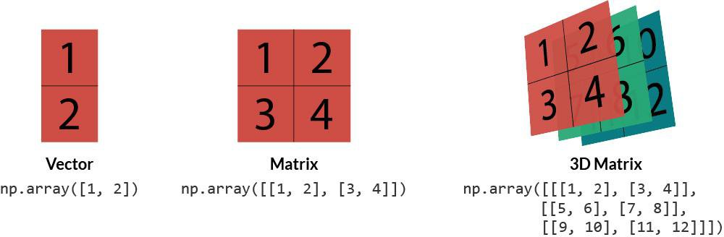
Numerical Computing with NumPy
(AKA Numerical Python)
Arrays: Creating, indexing, slicing, and reshaping arrays in numpy.
arr = np.array([[1, 2, 3], [4, 5, 6]])
Array operations: Performing element-based operations, broadcasting, and aggregation.
np.sum(arr)
Linear algebra: Performing matrix operations (e.g., matrix multiplication, transpose) and solving linear equations.
np.linalg.inv(arr)

Slide 6
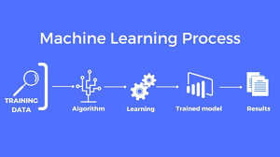
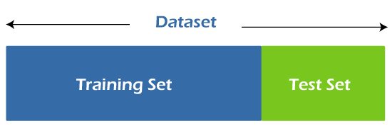
Introduction to Machine Learning with Scikit-learn (AKA Sklearn)
Supervised learning: Covers classification and regression tasks in machine learning.
from sklearn.linear_model import LinearRegression
Model training: Splitting data into training and test sets, fitting models to training data.
X_train, X_test, y_train, y_test = train_test_split(X, y, test_size=0.2)
Model evaluation: Measuring model performance using metrics like accuracy, precision, recall, and F1-score.
from sklearn.metrics import accuracy_score

Slide 7

Putting It All Together:
Data preprocessing: Using pandas and numpy to prepare data for modeling
(e.g., feature scaling, encoding categorical variables).
Example: Importing Standard Scaler, which is utilized for scaling features within a dataset
from sklearn.preprocessing import StandardScaler
Model building: Selecting and training a machine learning model using scikit-learn.
Example: Instance of Linear Regression ‘model’ is created and fitted to the training data
model = LinearRegression()
model.fit(X_train, y_train)
Model evaluation: Evaluating model performance and interpreting results to make data-driven decisions.
Example: Trained ML model ‘model’ used to make predictions ‘y_pred’ on set of features ‘X_test’
y_pred = model.predict(X_test)

Slide 8

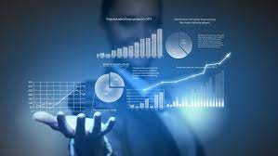
Now it’s your turn…
Explore common datasets like the Titanic and Diamonds datasets. Experiment with these to manipulate, analyze, and visualize data using pandas, numpy, seaborn, and matplotlib.
Build and train machine learning models using scikit-learn. Whether you're a beginner or more experienced in Python, this workshop offers something for everyone. Feel free to collaborate and utilize your resources. See the power of Python in data science for yourself!

Slide 9
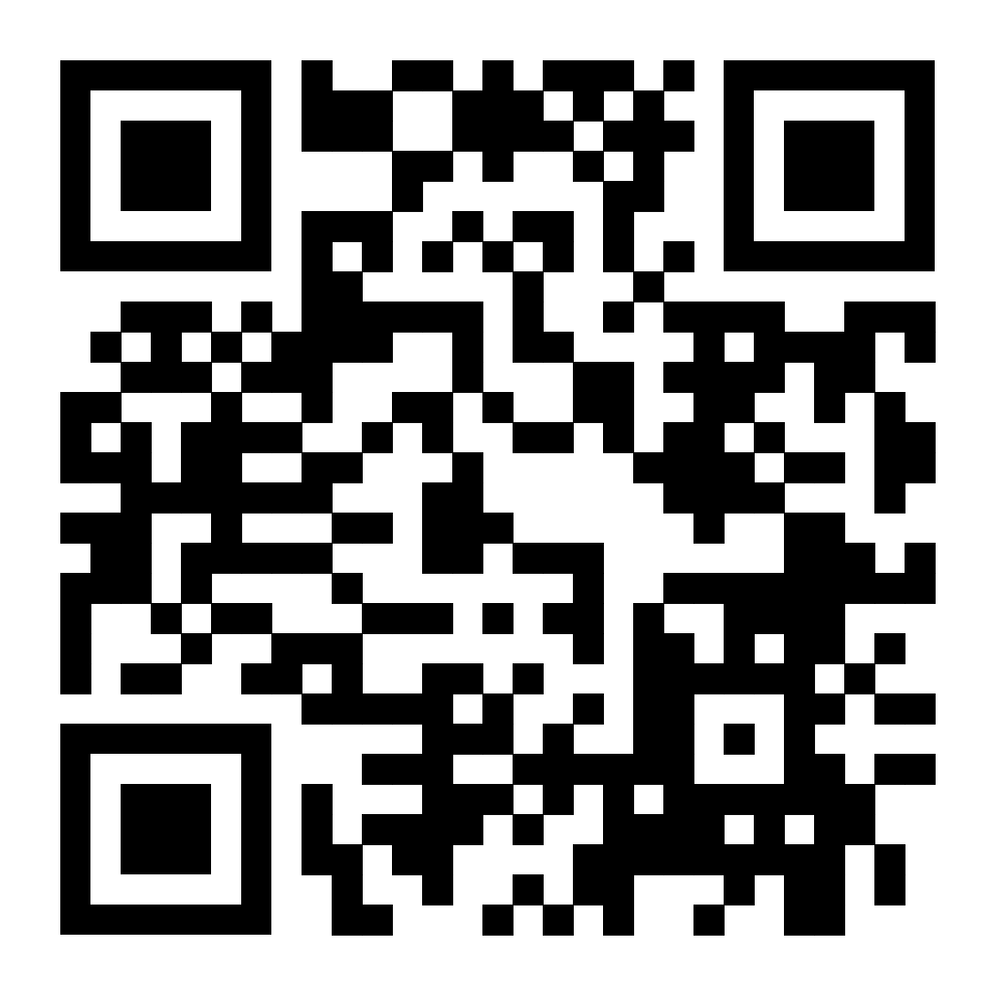

Our Socials! Join our Discord:
Instagram: @clt_ads
Linktree: https://shorturl.at/jkqKM
GitHub: https://github.com/DylanABenson24/
UNCC_Data-Science_Association

